Slide 1

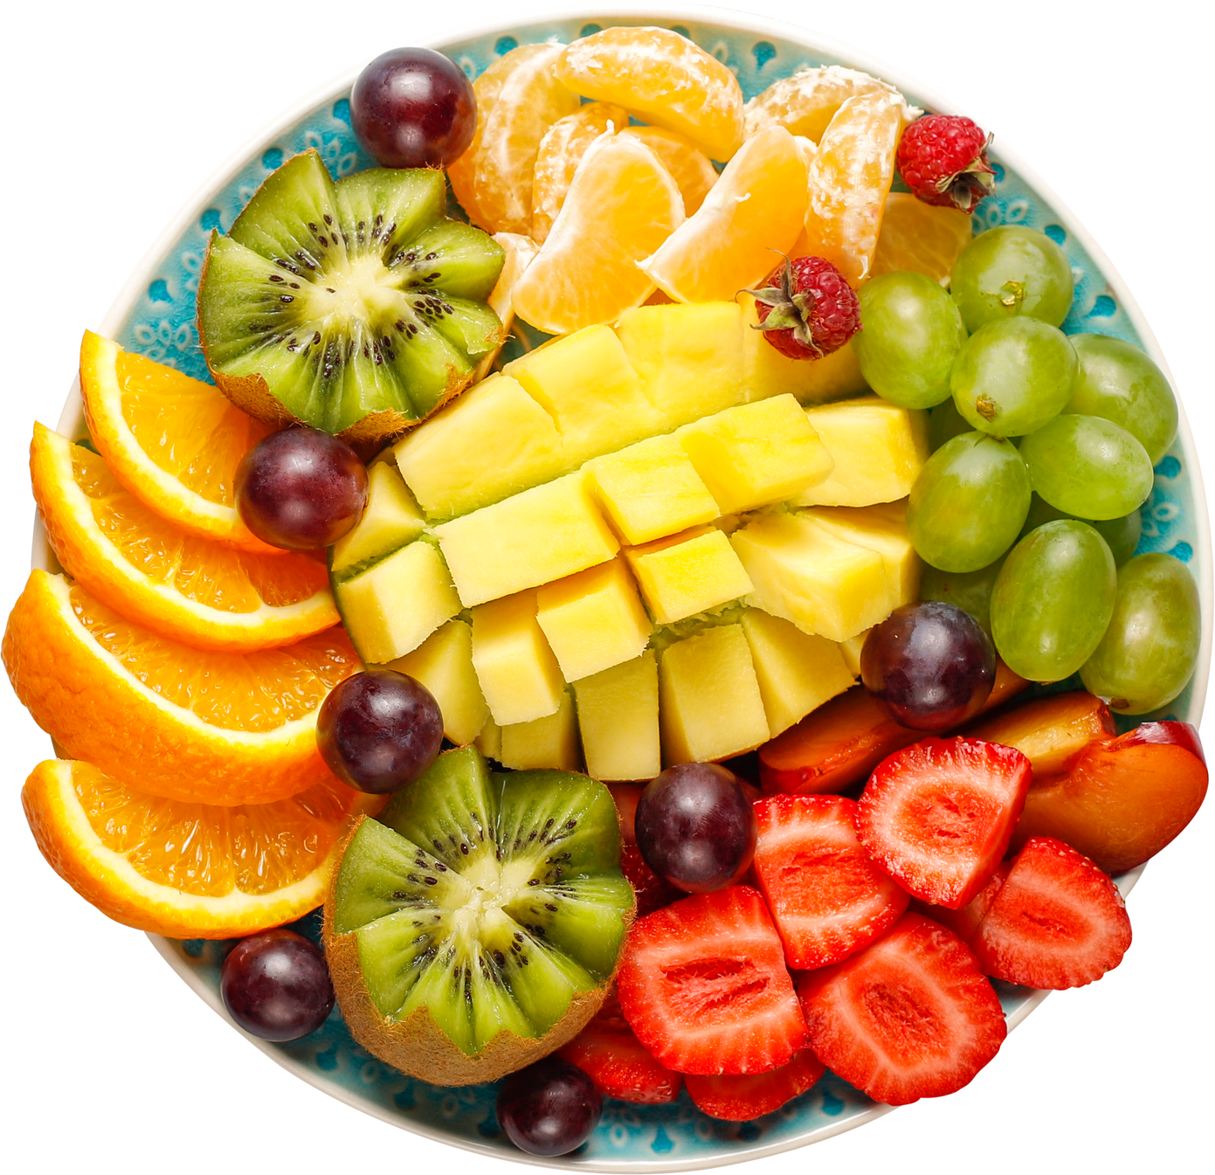
Fruity-Detect
Home
Visit
Project
Service
FRUITS
RECOGNITION
Mohamed Hesham – 2023/00428
Presented To: Dr. Alaa Hamdy
Visit Us

Slide 2

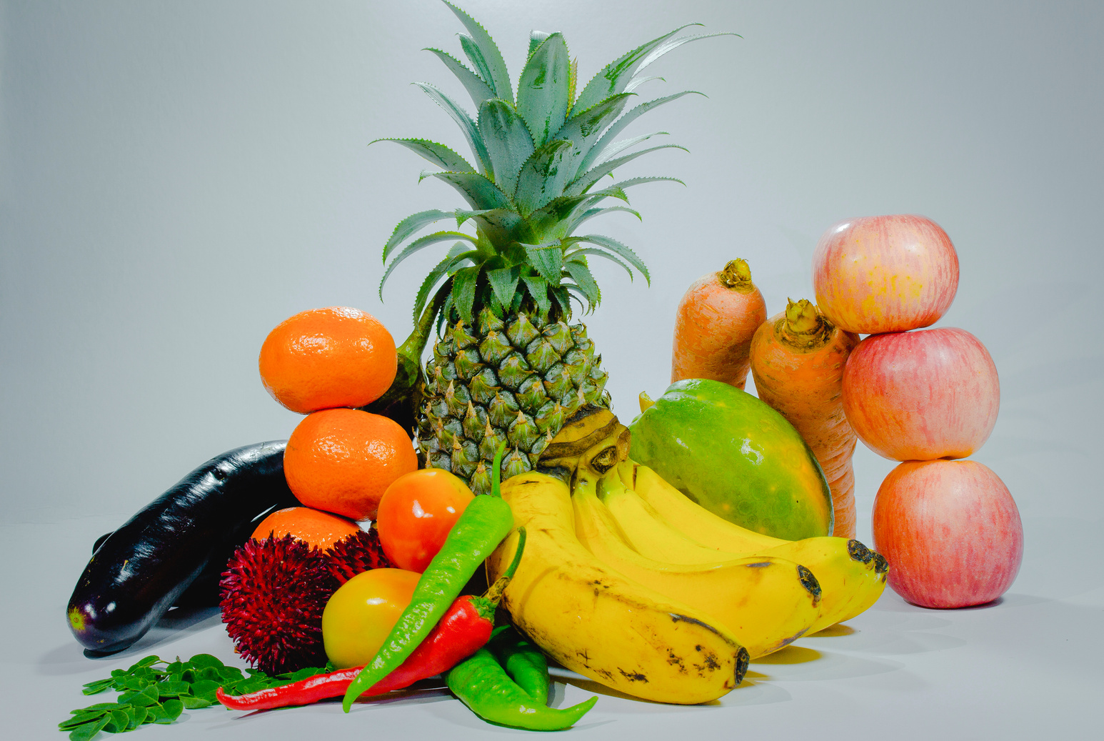
Ingoude Company
Home
Visit
Project
Service
Fruity-Detect
Home
Visit
Project
Service
Problem Description 01
Manual fruit classification remains slow and inconsistent, creating a demand for an automated, vision-based solution suitable for
real-time use in agriculture and retail.
ABOUT
FRUITS
Project Objectives 02
To build an accurate and efficient fruit recognition system using image processing and machine learning, capable of real-time classification via a web application.

Slide 3
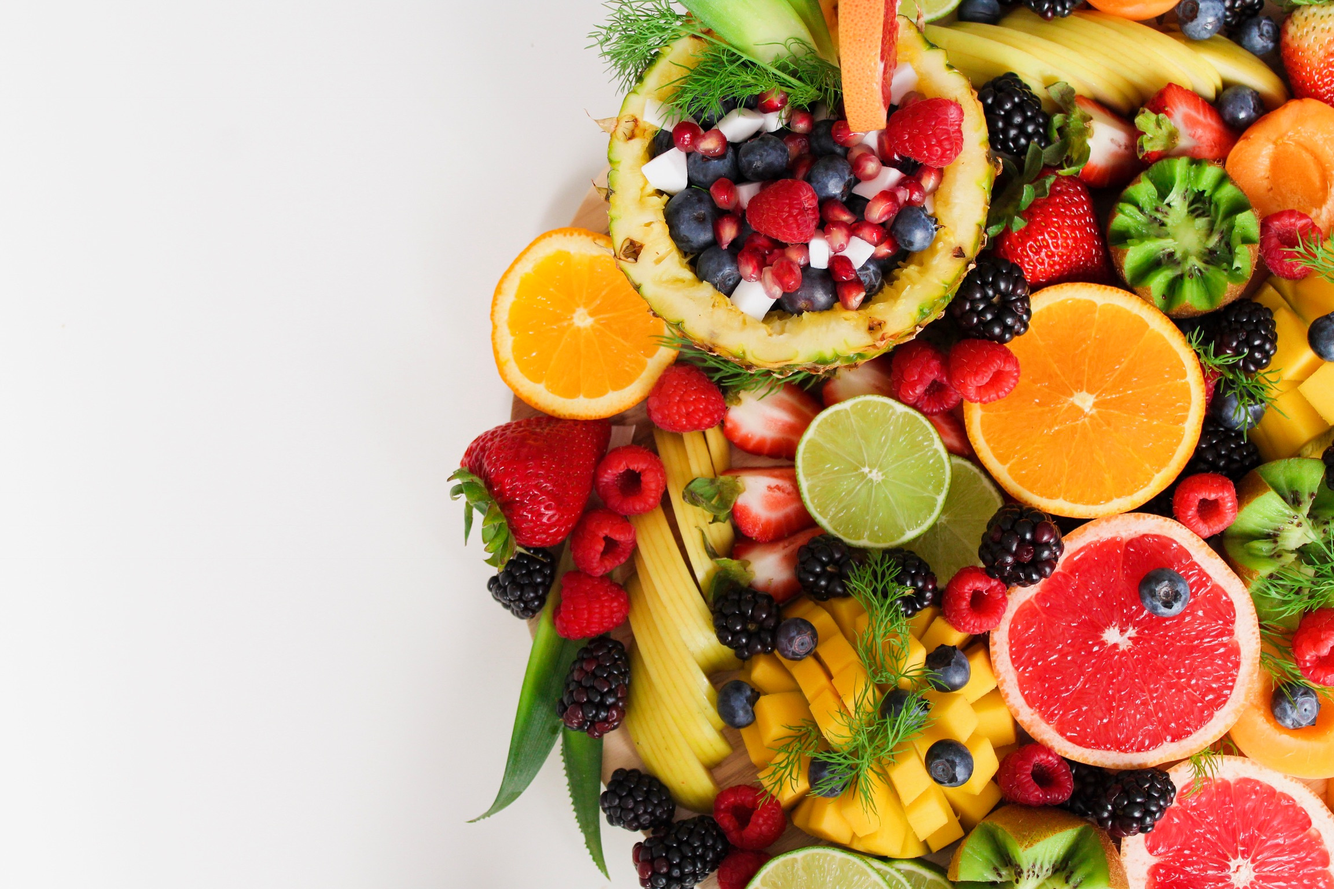
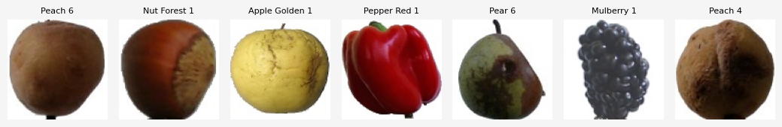
Ingoude Company
Home
Visit
Project
Service
Fruity-Detect
Home
Visit
Project
Service
Dataset!
Overview
The model was trained on the Fruits-360 dataset from Kaggle, organized into training, and testing directories, each containing labeled fruit images.
The number of unique fruits were 230 fruits, with over 150k+images (including training & testing).

Slide 4

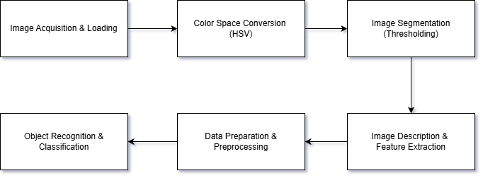
Ingoude Company
Home
Visit
Project
Service
Fruity-Detect
Home
Visit
Project
Service
Fruit Recognition Pipeline

Slide 5

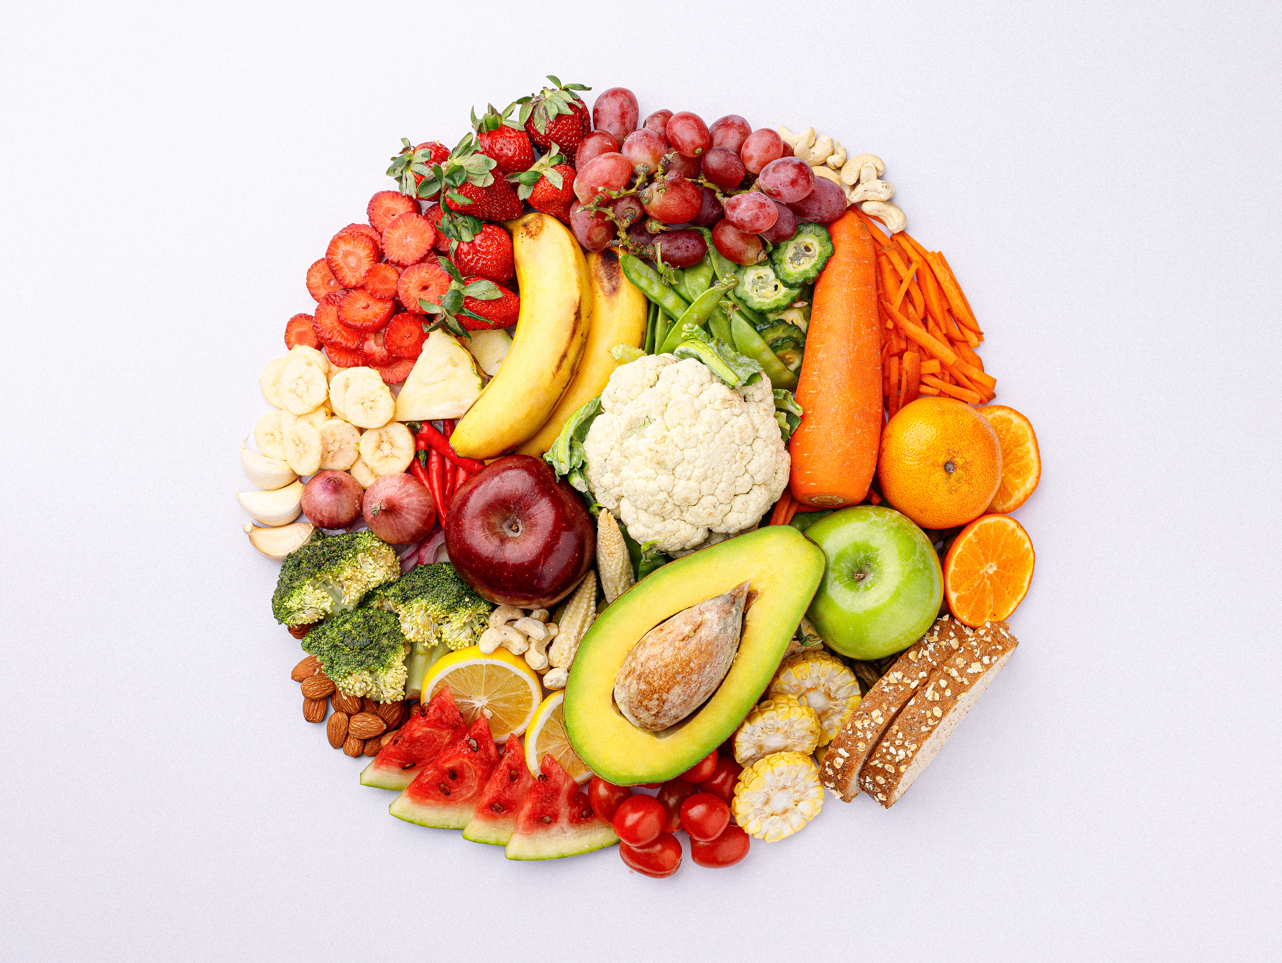
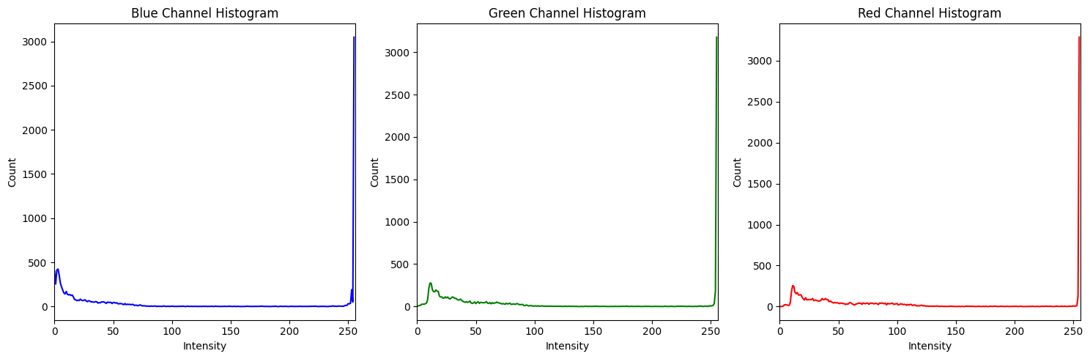
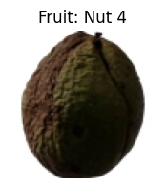
Fruity-Detect
Home
Visit
Project
Service
1. Image Acquisition & Loading
- Dataset divided into Training and Testing directories.
- Subfolders are organized by fruit class & each image is 100x100.
- Used paths:
Training: /kaggle/input/fruits/fruits-360_100x100/fruits-360/Training
Testing: /kaggle/input/fruits/fruits-360_100x100/fruits-360/Test
Implementation
Steps

Slide 6
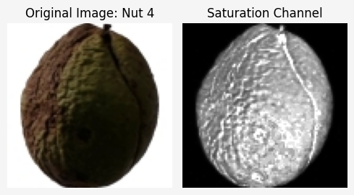
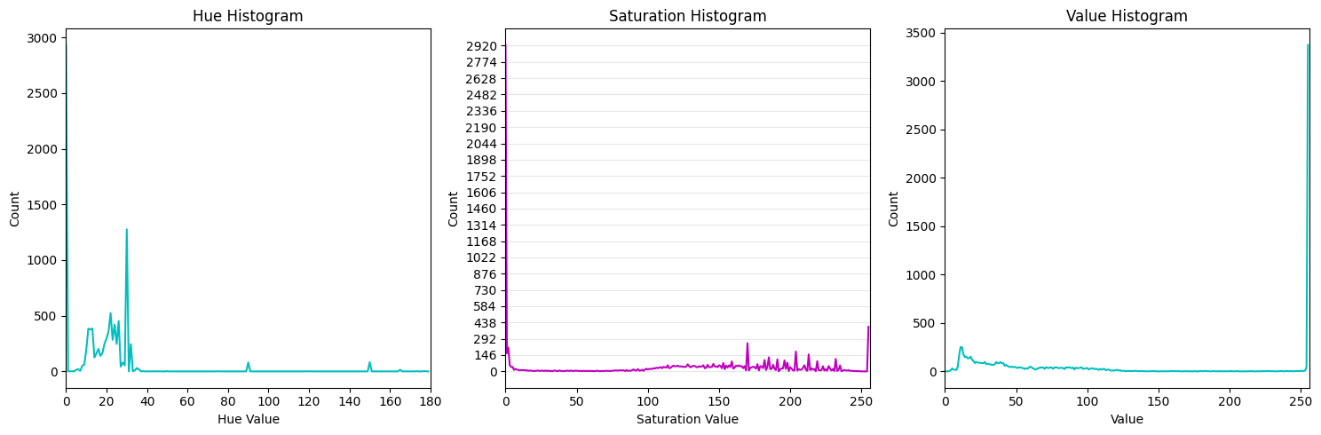
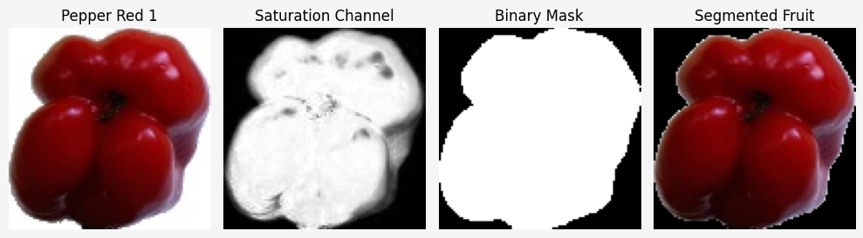
Fruity-Detect
Home
Visit
Project
Service
2. Color Space Conversion (HSV)
- Converted images from BGR to HSV
- Extracted the saturation channel for segmentation
- Why the saturation channel?
1. White background has very low saturation (near 0)
2. Fruits have high saturation (near 255)
3. Creates clear separation for thresholding
- Used hue and value channels later for feature extraction
3. Image Segmentation (Thresholding)
- Applied binary thresholding on the saturation channel
- Threshold value: 15 (chosen through trial & error)
- Result: Binary mask where:
1. fruit = white (255)
2. background = black (0)
- Enabled isolation of fruit region for further processing

Slide 7
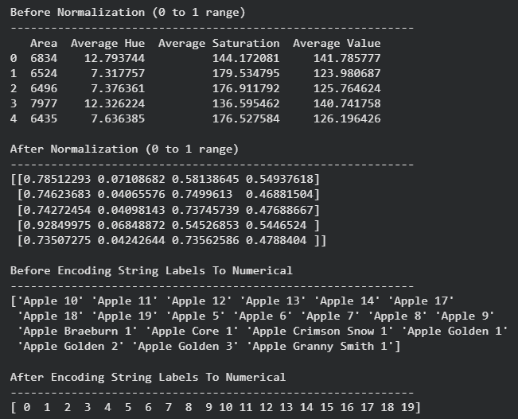
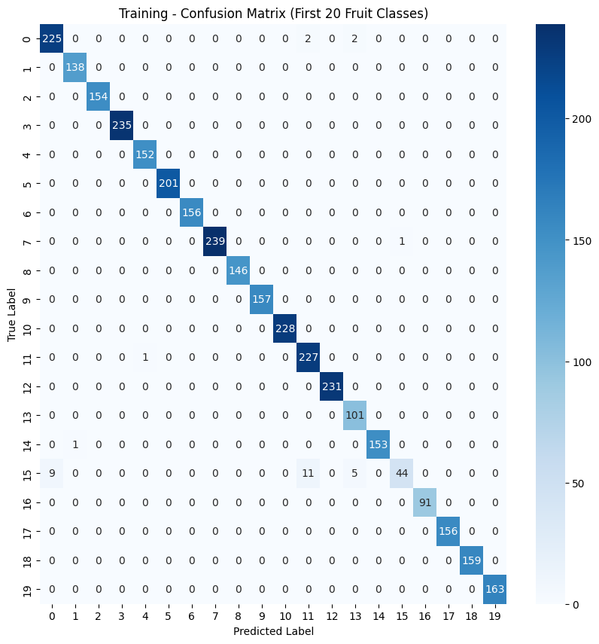
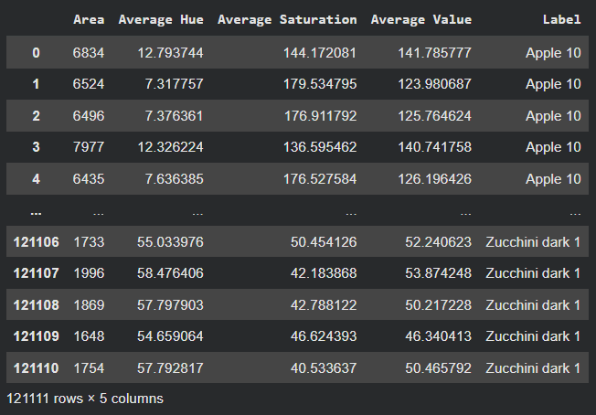
Fruity-Detect
Home
Visit
Project
Service
4. Image Description & Feature Extraction
5. Data Preparation & Preprocessing
6. Object Recognition & Classification
- Extracted 4 numerical features from each segmented fruit:
1. Area - pixel count of fruit region
2. Average Hue - dominant color
3. Average Saturation - color purity
4. Average Value - brightness
Features stored as a vector for machine learning!
- Features normalized using MinMaxScaler (range 0 to 1)
- Labels encoded from text to numbers using LabelEncoder
Ensured consistent scaling between training and testing data!
- Trained and compared testing accuracies:
1. k-NN (k=3, Euclidean distance)
2. Random Forest (100 trees)
- Random Forest achieved 92.04% accuracy
Model saved with scaler & encoder for deployment!!

Slide 8
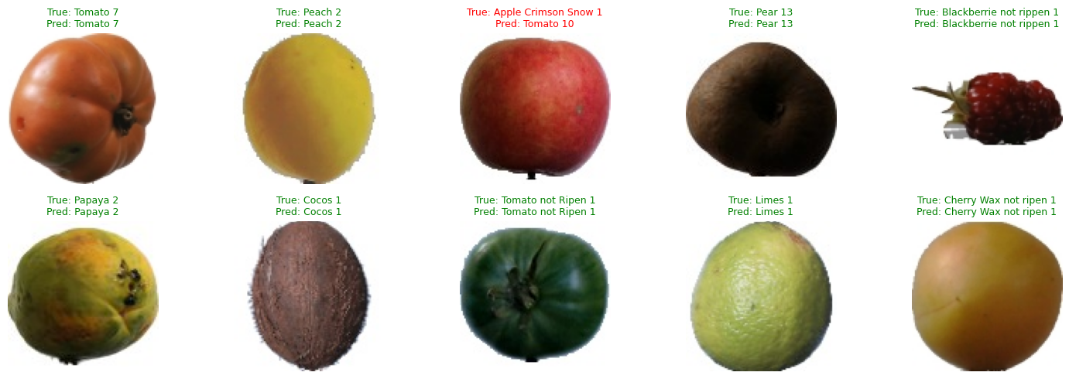
Ingoude Company
Home
Visit
Project
Service
Fruity-Detect
Home
Visit
Project
Service
Testing Results

Slide 9
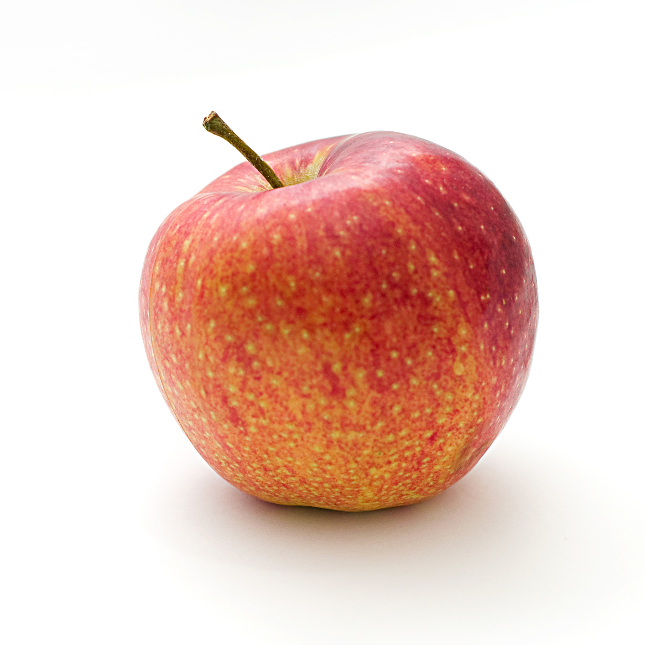
Ingoude Company
Home
Visit
Project
Service
Fruity-Detect
Home
Visit
Project
Service
Fruity-Detect
Home
Visit
Project
Service
Fruity-Detect
Home
Visit
Project
Service
Web Application Deployment
- Built with Flask
- Users upload an image and is processed through the same pipeline.
- Model predicts fruit type and result is displayed in real-time
- Full system: From image to prediction in seconds

Slide 10
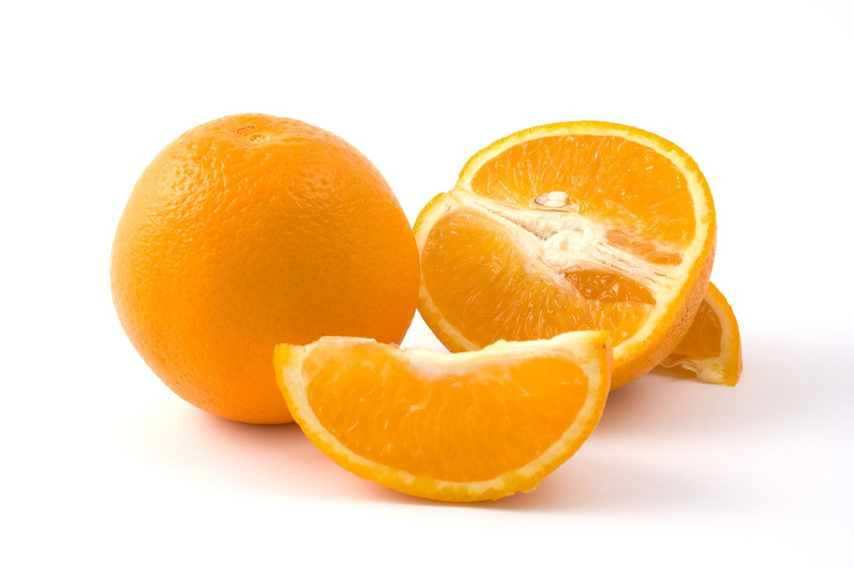
Ingoude Company
Home
Visit
Project
Service
Fruity-Detect
Home
Visit
Project
Service
Fruity-Detect
Home
Visit
Project
Service
THANK YOU!

